Slide 1
Web Based Student Facilitation System

Slide 2
Team
Supervisor
    Dr. Atif Saeed
    Assistant Professor (CS)
Co-Supervisor
    Mr. Junaid Anjum
    Lecturer (CS)
Hamza Mahmood (Team Leader)
    SP16-BSE-018
Waqas Nosher
    SP16-BSE-106
M . Alamgir khan
    SP16-BSE-006

Slide 3
Introduction
A non-profit organization.
Centralized platform to get education related information.
Managing all data related to the universities, programs, faculties, events.
Evaluation of programs based on user’s rating.
Uploading/Downloading of course related books and notes.

Slide 4
Problem Statement
  Increasing trends towards digital world to get information.
  No platform is providing authentic and unambiguous information.
  A much needed platform for foreign students and hostelers.
  Excludes the needs of visiting the institutes physically.
  Wastage of time and money.
  Unavailability of free resources for students.

Slide 5
Objectives
  To diversify the study process and make it more interesting, efficient and contemporary.
  To make information available for everyone.
  To make the information and study materials freely available for learners.

Slide 6

Architecture

Slide 7
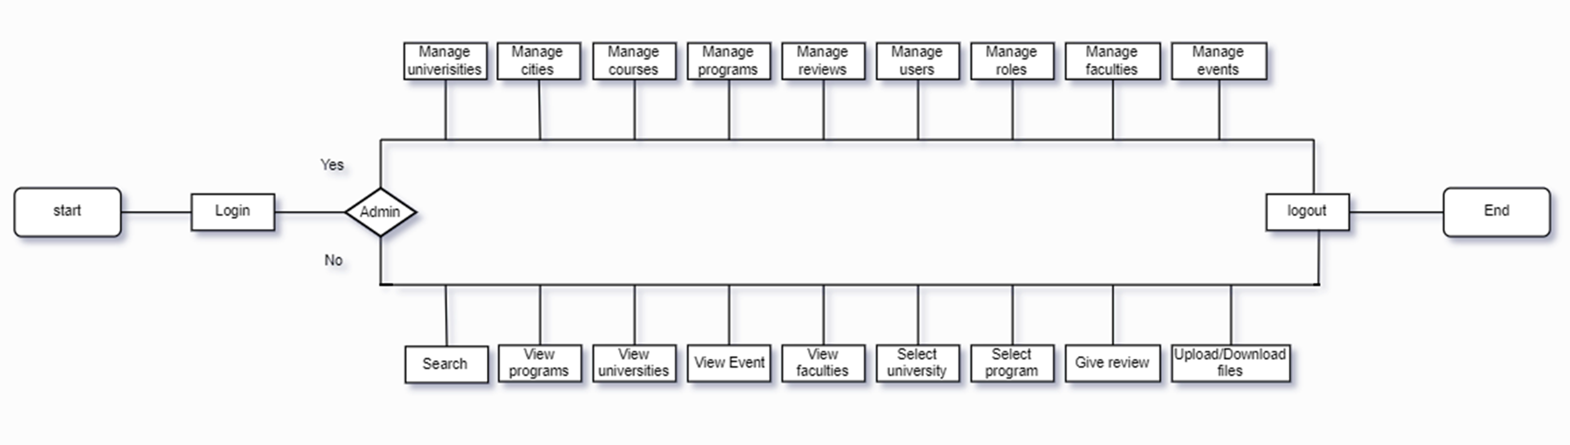
Flow Chart

Slide 8


Tools and Technology Used

Slide 9
Target Market

Slide 10
Related Work
Top Universities
Ilm Ki Duniya
Eduvision

Slide 11
Future Work
Cover remaining cities and their respective universities.
Focus on subjects rather than programs.
Add new features like, Comparing Programs.
Android and IOS app development

Slide 12
Core Functionalities
Signup/Login
Upload/Download contents
Approve/Disapprove of contents
Rating system
Managing universities, programs, events, users, roles, attachments
Adding new data

Slide 13
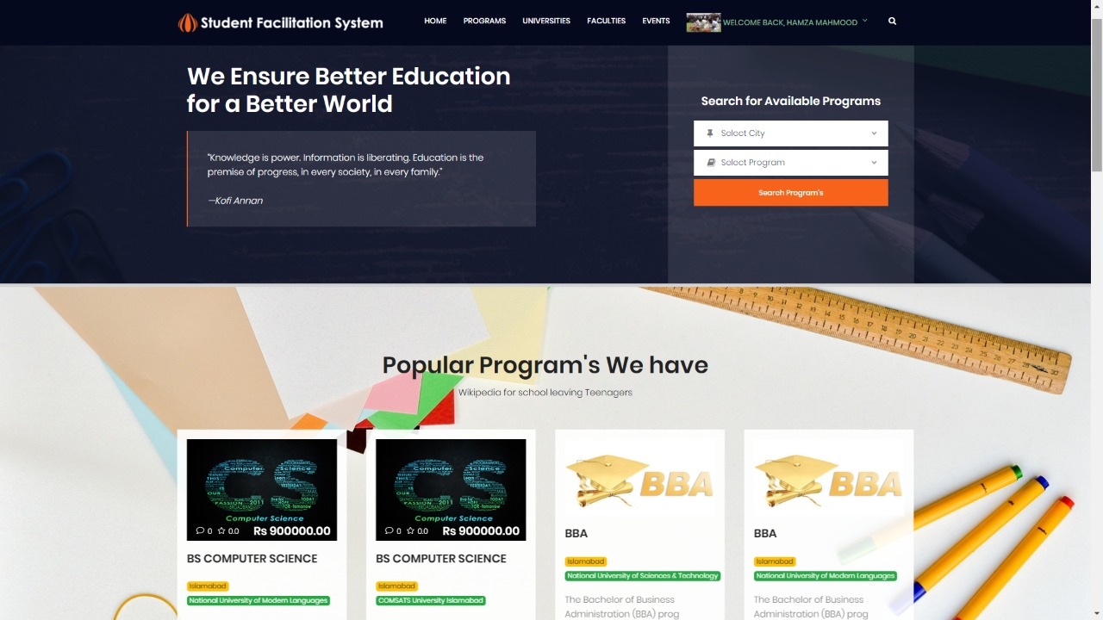
Prototype

Slide 14
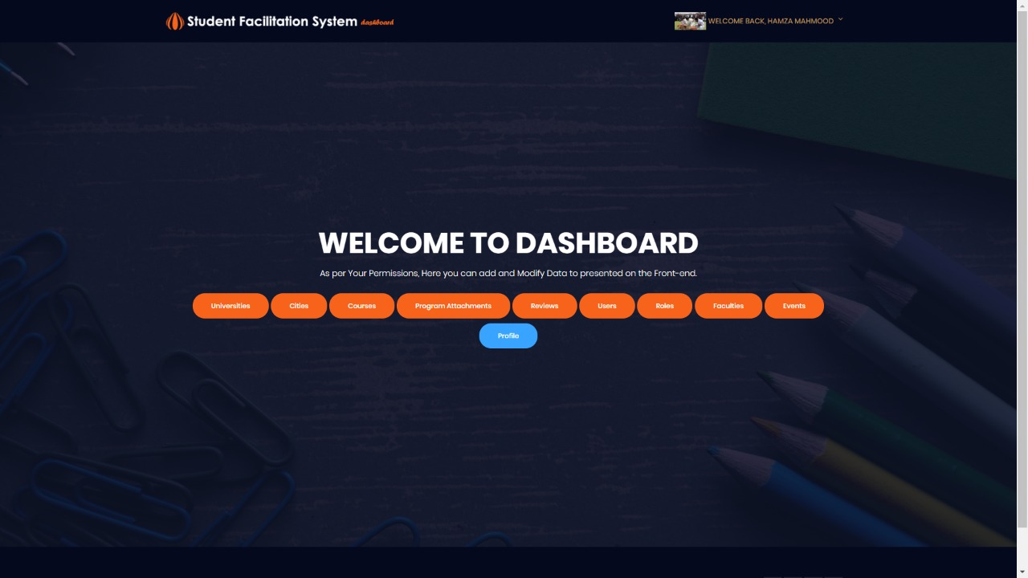

Slide 15
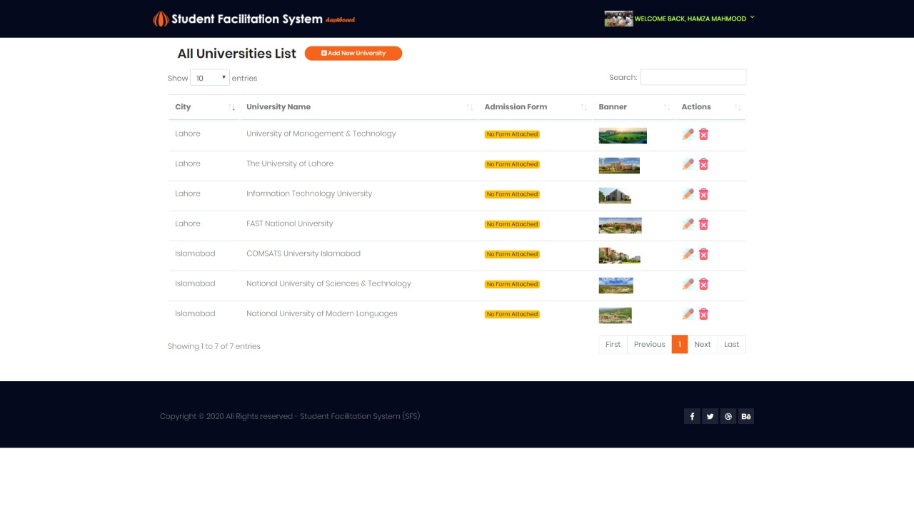

Slide 16
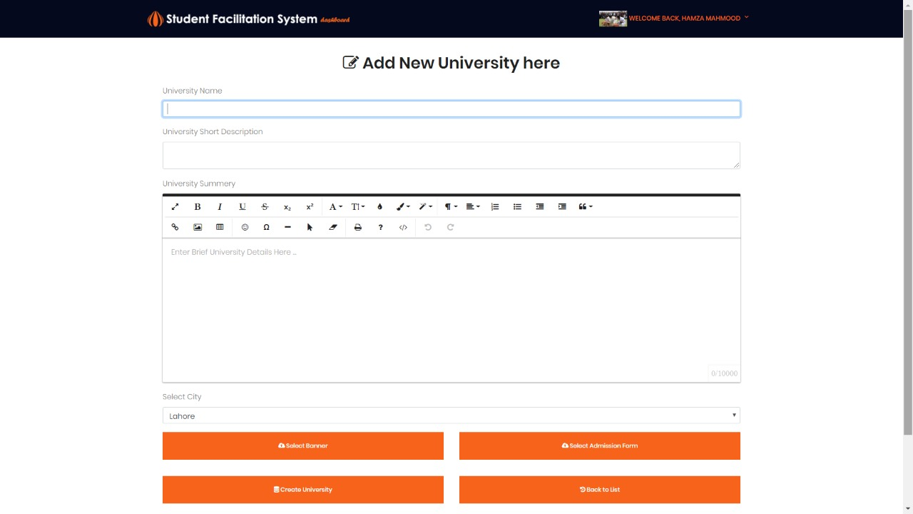

Slide 17
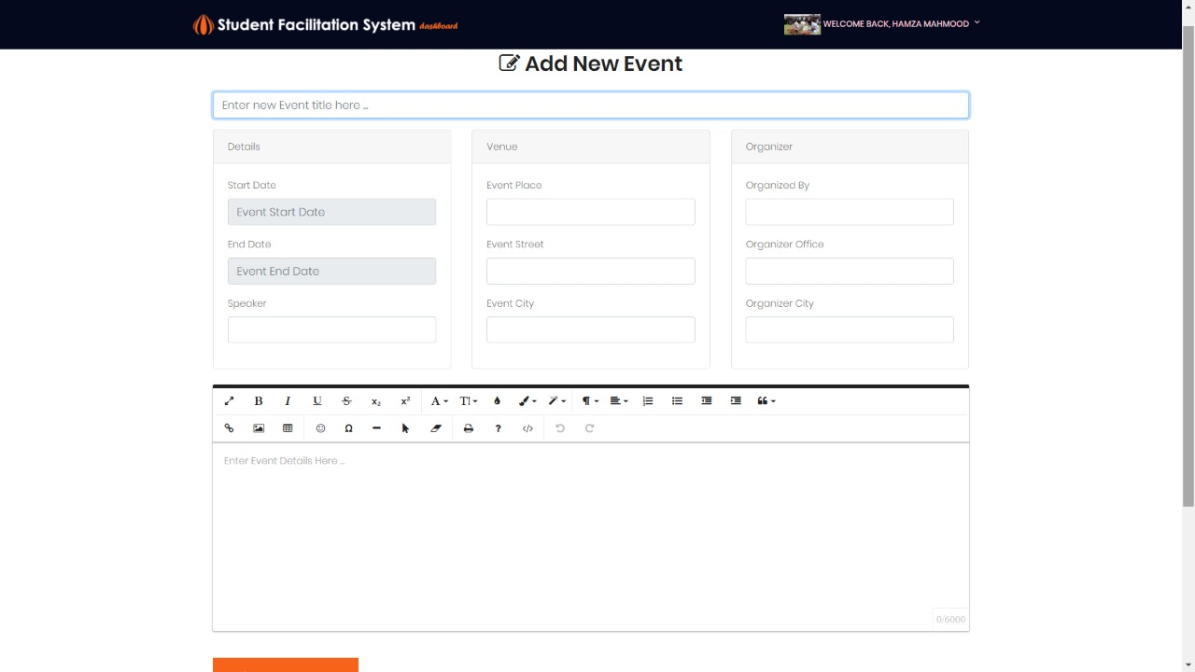

Slide 18
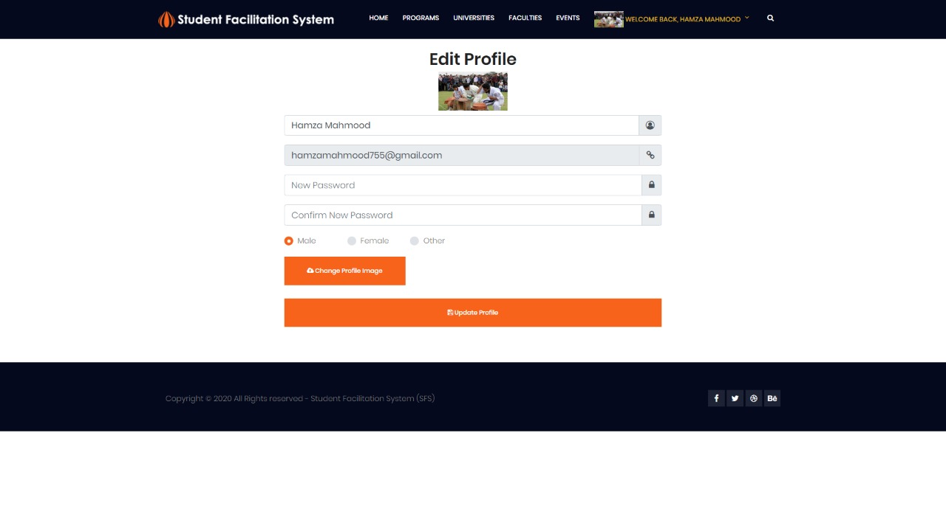

Slide 19
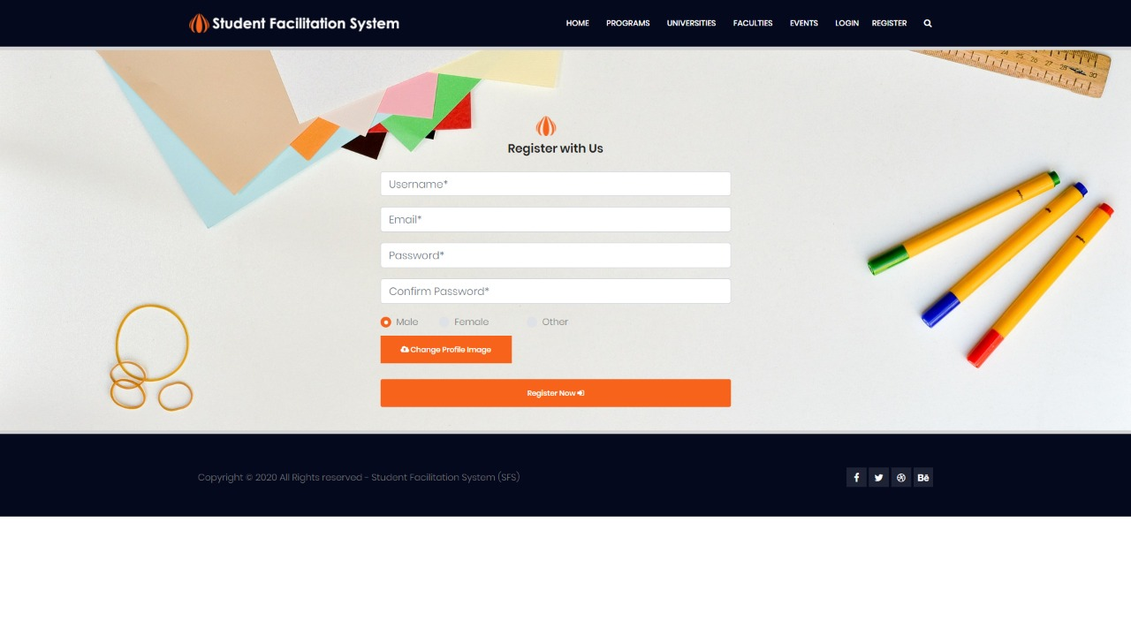

Slide 20
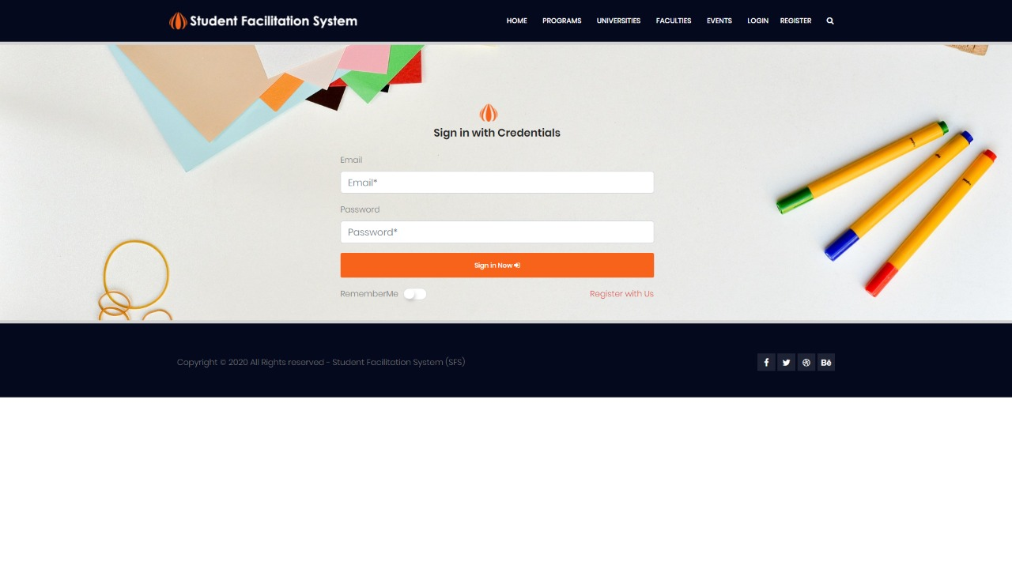

Slide 21
Conclusion
This product will provide single platform to students to get all the information about the major universities. It will provide all the information about the admission procedures, faculty, fee structure and their study scheme. System will provide the facility to users to update their profiles. Students can also get the information related to events of specific universities or city. Books of specific subjects will also be available and if someone wants to upload any book that can be helpful for someone, the system will give him/her facility to upload.

Slide 22
Demonstration

Slide 23
Thank you!!

